Slide 1
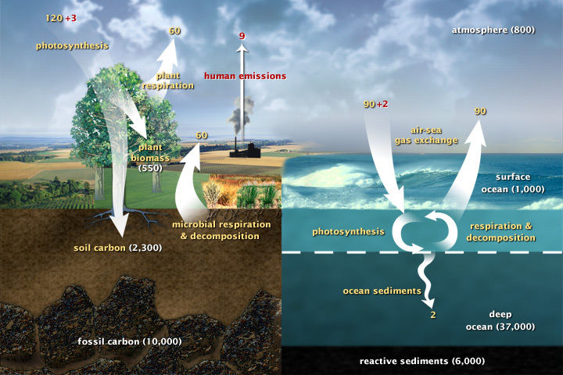
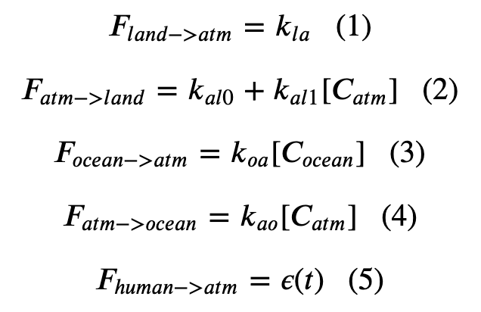
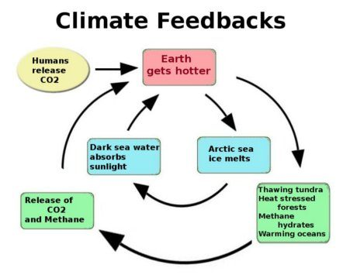
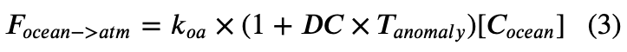

Summary of climate capabilities in Cambio 1-4
Cambio 1.0
Our five basic equations
Cambio 2.0
Added Henry’s effect
Cambio 3.0
Included ice-albedo feedback
Cambio 4.0
Includes terrestrial $CO_{2}$ fertilization feedback

Slide 2
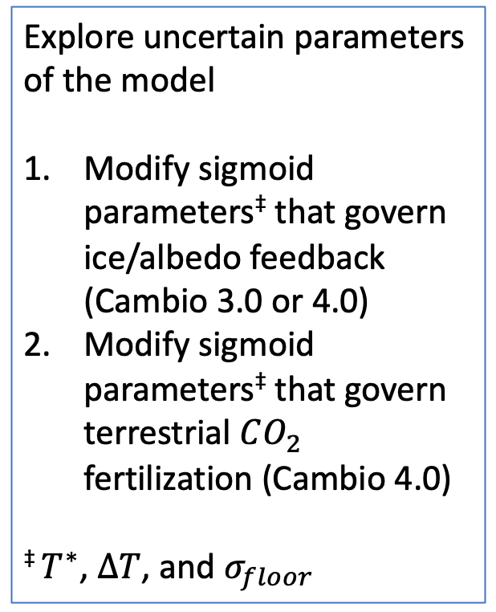
Modeling Project ideas
Study the following effects
How the timing of peak emission affects the likelihood of achieving climate goals (e.g., staying under 𝟐℃)
How the magnitude of long-term emissions affects those ambitions
How shortening or extending the decarbonization time affects those ambitions
No new code needed, just multiple runs of ScheduledFlowsLTE & Cambio4.0.
Explore uncertain parameters of the model
Modify sigmoid parameters‡ that govern ice/albedo feedback (Cambio 3.0 or 4.0)
Modify sigmoid parameters‡ that govern terrestrial $CO_{2}$ fertilization (Cambio 4.0)
‡ $T^{∗}$, $∆T$, and $σ_{floor}$
New Python code
Stabilization of an ice-free Arctic
Negative carbon emissions
Nuclear winter
Ice-free Himalayas
Modeling the AMOC
Stochastic Cambio
Other ideas …
Impacts of “Flying Less” or other Carbon abolition movements
Carbon offsets

Slide 3
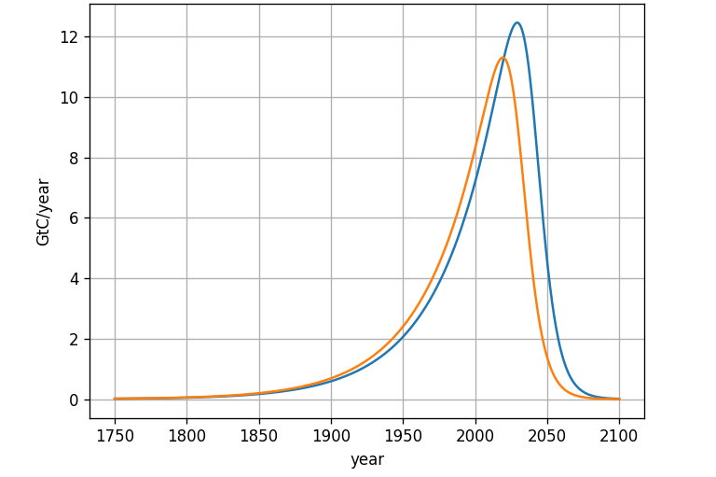
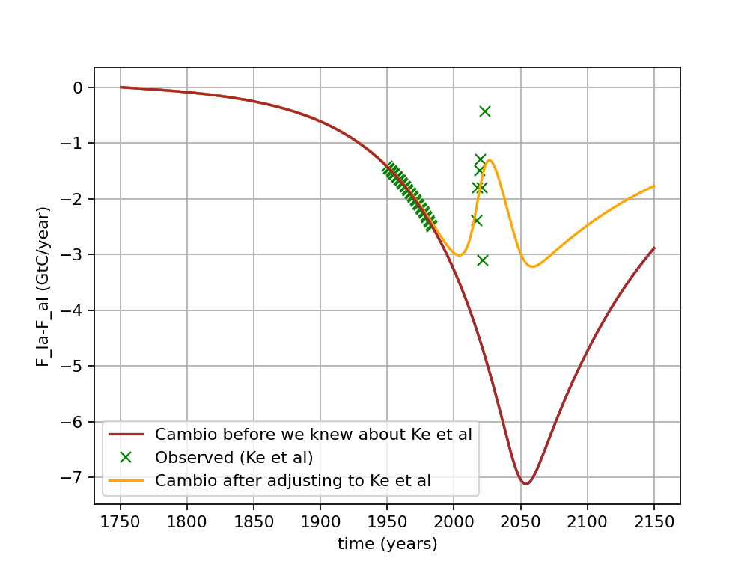
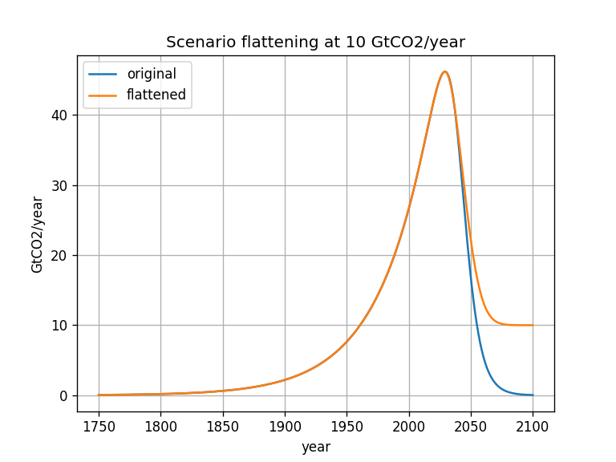
How long can we delay peak emissions or modify long term emissions (and still stay under $2℃$)

Slide 4
Current climate change popular movements
350.Org
Extinction Rebellion America
Sunrise movement
(More are listed at https://en.wikipedia.org/wiki/Climate_movement)
Questions for current movements …
What motivates individuals to join?
What are the goals of the organization (e.g., divestment)
What are the organizational alliances?
What resources do they have?
How successful are they?
Who benefits/how does it function/where is the power (Schremph)
Substitution as a rhetorical tool (Rowe)

